Slide 1

PRE-AI
GEN 1
GEN 2
GEN 3a
GEN 3b
The Geological Ages of
AI-Assisted Development
An Evolution Timeline — And Where We Stand Today
DRAFT — December 2025
[ Logo Placeholder ]

Slide 2
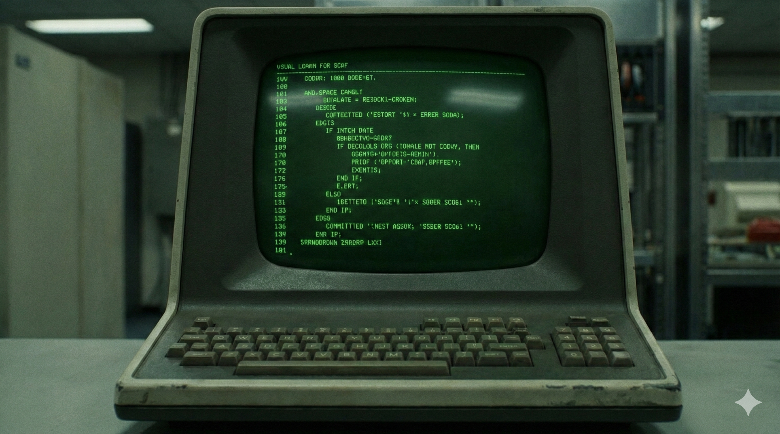
PRE-AI ERA
The Foundation • 1950s-1980s
TIMELINE
Early Computing
PRE-AI
The origin of life — green phosphor displays, worn keyboards, industrial computing.
GEN 1
Characteristics:
GEN 2
Manual code entry on terminals
Punch cards and batch processing
No syntax assistance
Knowledge in manuals and minds
GEN 3a
GEN 3b

Slide 3
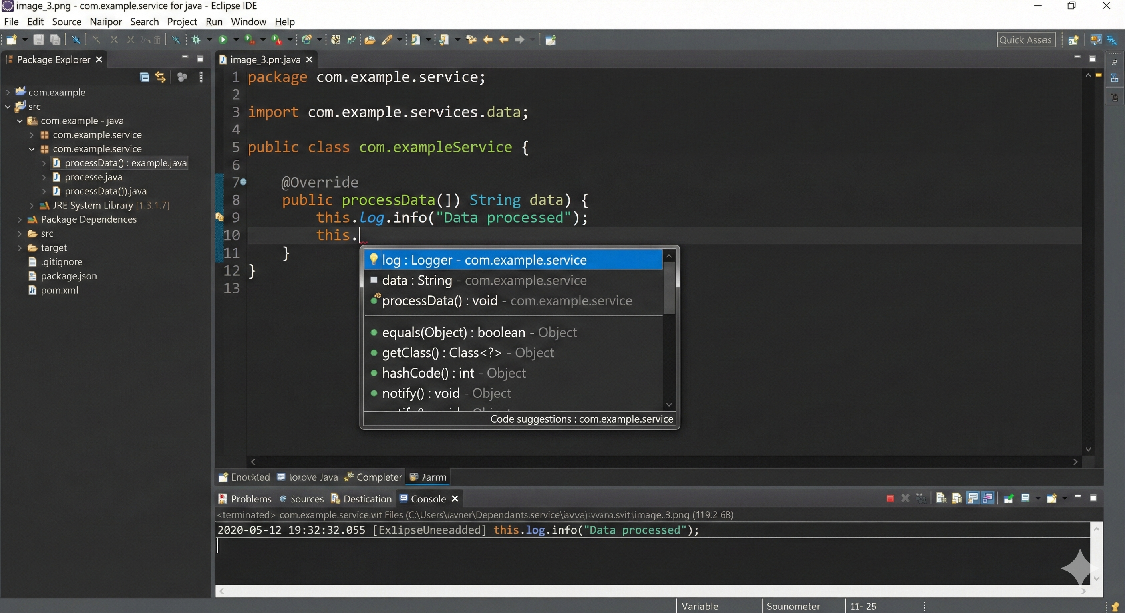
PRE-AI ERA
Sophisticated Tooling • 1990s-2010s
TIMELINE
Classic IDE Era
PRE-AI
Sophisticated but deterministic. Intelligent suggestions powered by parsing — no learning.
GEN 1
Characteristics:
GEN 2
Syntax highlighting and navigation
Rule-based autocomplete
Static analysis and linting
Integrated debugging
GEN 3a
GEN 3b

Slide 4
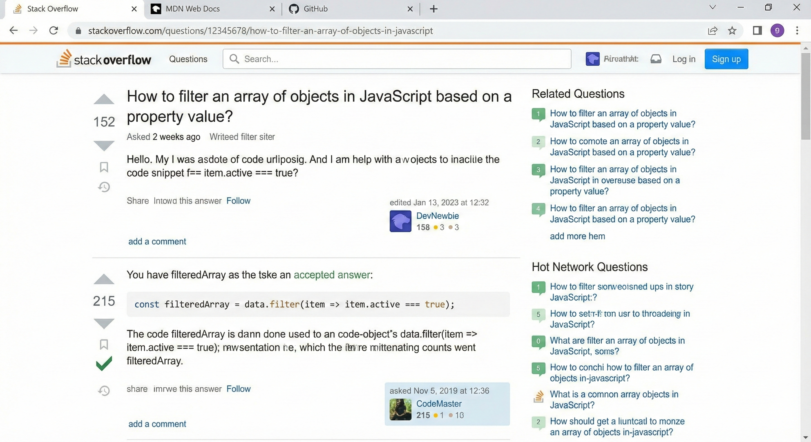
PRE-AI ERA
Collective Knowledge • 2008-2020s
TIMELINE
Stack Overflow Era
PRE-AI
Collective human knowledge. Upvotes, green checkmarks, copy-paste workflows.
GEN 1
Characteristics:
GEN 2
Search → Find → Copy → Adapt
Community-curated answers
Human experts as gatekeepers
GEN 3a
GEN 3b
⚠ Extinction Event: Declines as conversational AI emerges

Slide 5
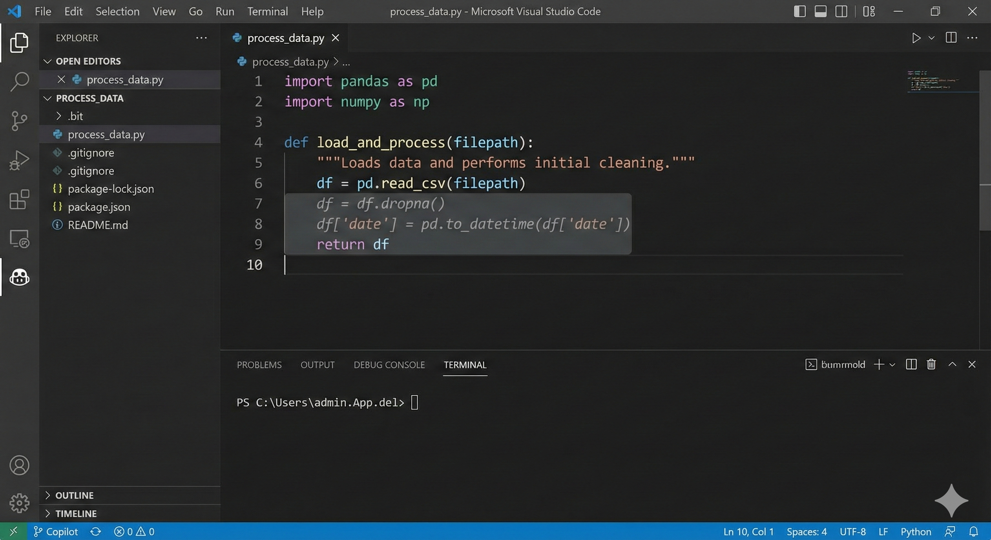
GEN 1 — AI ERA BEGINS
ML Code Completion • 2021-2022
TIMELINE
PRE-AI
The Cambrian Explosion
For the first time, AI predicts multiple lines of contextual code — not just method names.
GEN 1
Key Innovations:
GEN 2
ML-powered predictions
Context-aware multi-line suggestions
Trained on billions of code lines
GEN 3a
GEN 3b
GitHub Copilot
Tabnine
Codeium

Slide 6
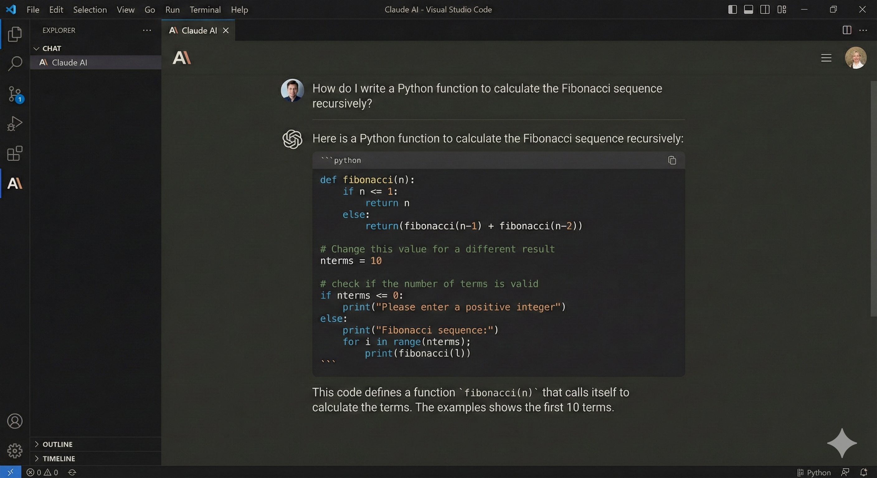
GEN 2
Conversational AI • 2022-2024
TIMELINE
PRE-AI
The Dialogue Begins
Natural language in, explained code out. AI understands intent, provides context, explains reasoning.
GEN 1
GEN 2
Paradigm Shift:
Ask in natural language
Receive explained code
Iterate through conversation
GEN 3a
GEN 3b
ChatGPT
Claude
Gemini

Slide 7
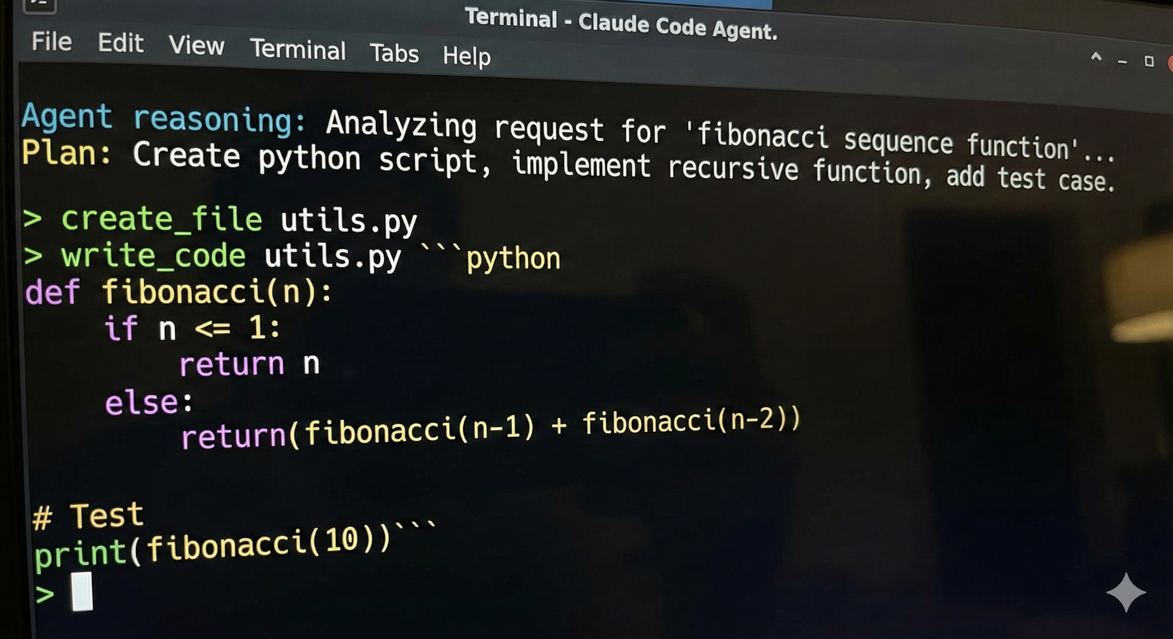
GEN 3a
Autonomous Agents • 2024-Present
TIMELINE
From Dialogue to Autonomy
PRE-AI
AI reasons, plans, and executes. You provide intent, it delivers outcomes.
GEN 1
Agentic Capabilities:
GEN 2
Autonomous planning
File system operations
Multi-step execution
Self-correction
GEN 3a
GEN 3b
Claude Code
Cursor Agent
Windsurf

Slide 8
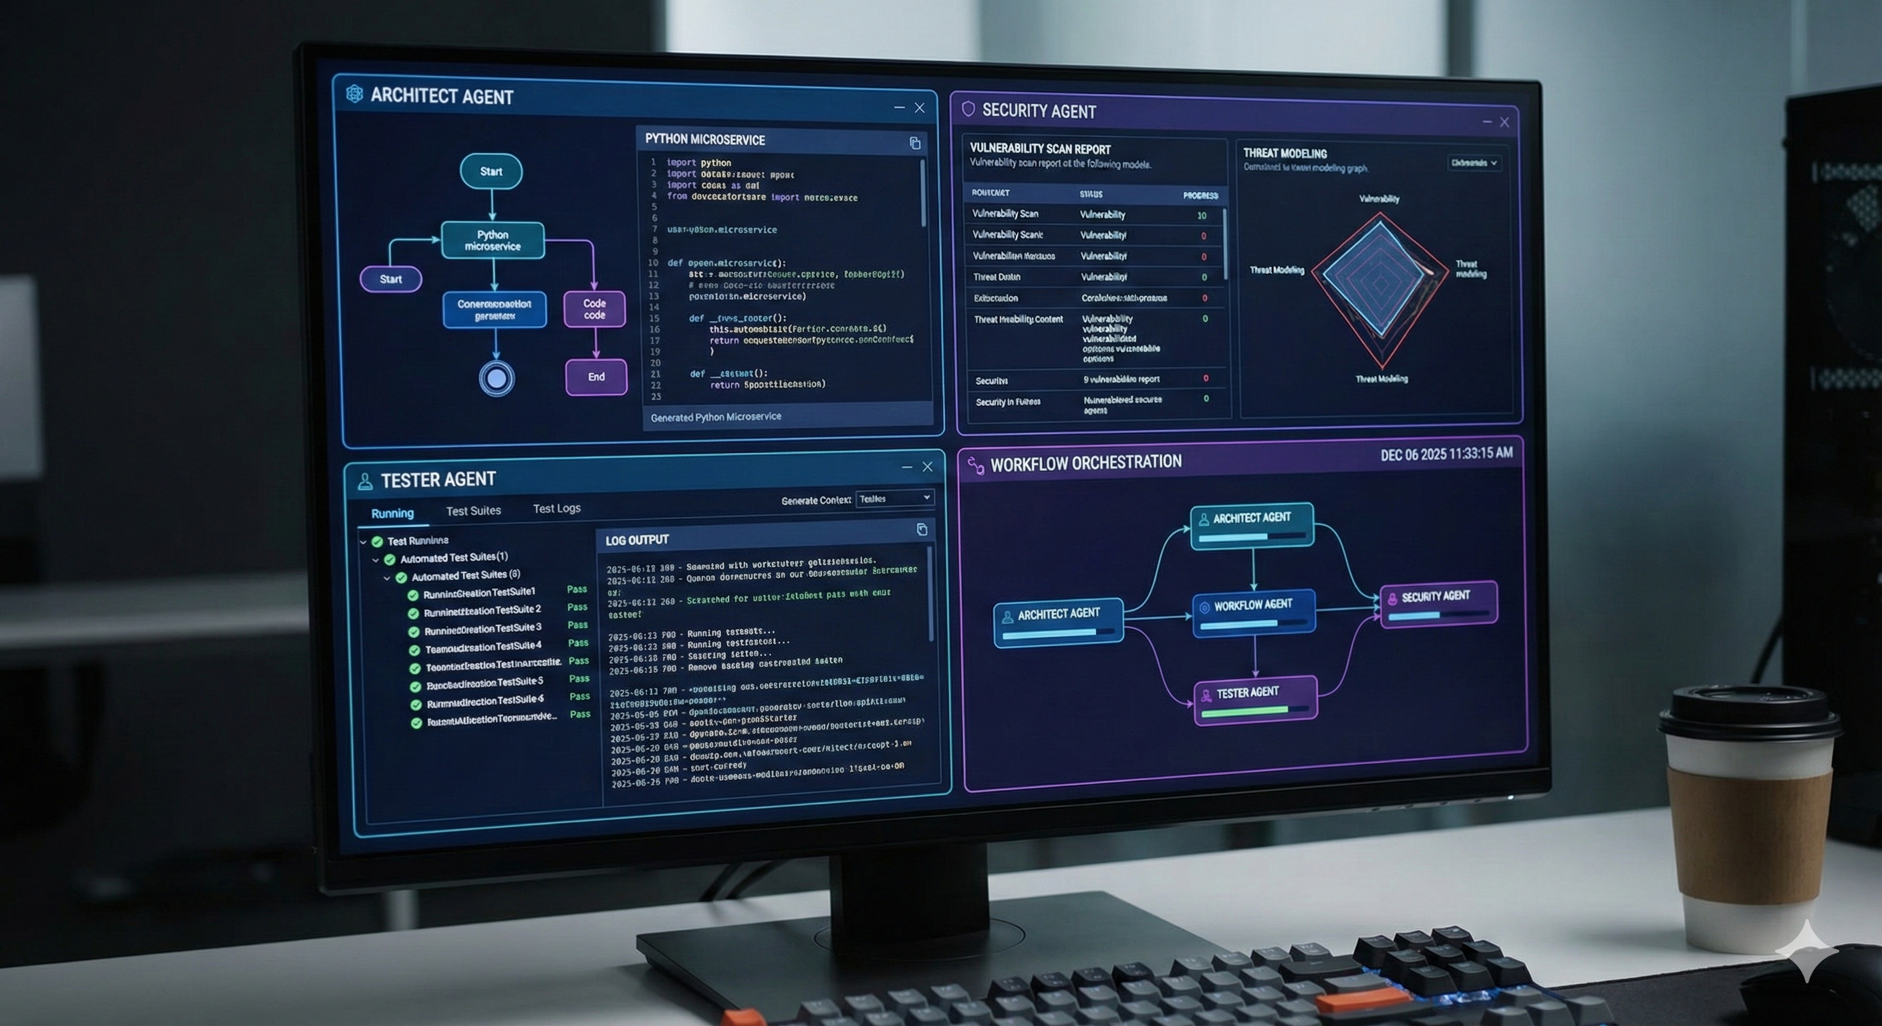
GEN 3b
Agentic Factory • Emerging Now
TIMELINE
PRE-AI
The Emergence of Civilization
Specialized agents — Architect, Security, Tester — orchestrated into a collaborative factory.
GEN 1
GEN 2
Multi-Agent Architecture:
Specialized agent roles
Workflow orchestration
Collaborative problem-solving
GEN 3a
GEN 3b
Architect
Security
Tester
Workflow

Slide 9

You Are Here
Industry Standard — Modern Technology Stacks
PRE-AI
GEN 1
GEN 2
GEN 3a
GEN 3b
YOU ARE HERE
LEADING EDGE
TOOLING
Python, JavaScript, TypeScript, Go, Rust
Claude Code, Cursor, Windsurf, Copilot
For modern cloud-native technology stacks, the industry is at the Gen 3a frontier

Slide 10
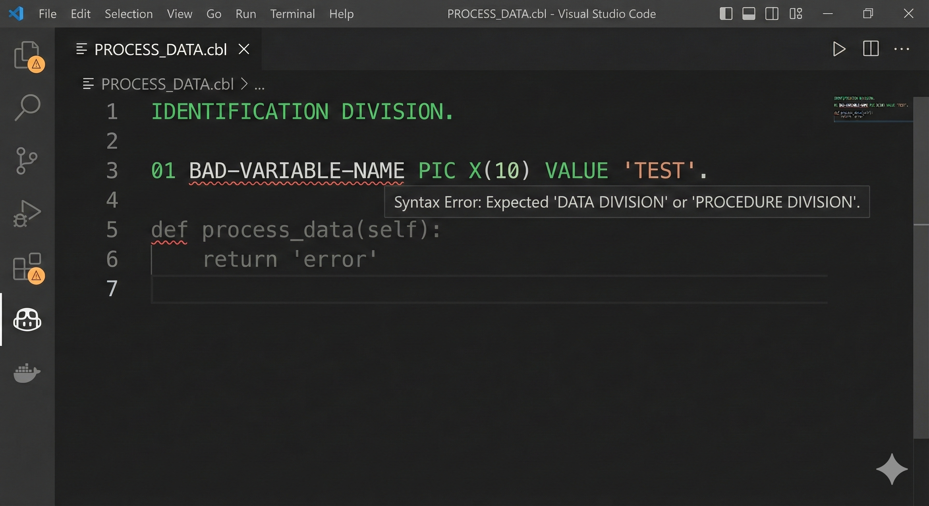
⚠ THE GAP
Mainframe Reality
THE GAP
But for Mainframe...
PRE-AI
Modern AI falls apart with COBOL. The AI hallucinates Python inside a COBOL file.
GEN 1
The Reality:
GEN 2
Limited COBOL/CICS/DB2 training data
No mainframe toolchain integration
AI can't "see" zOS environments
GEN 3a
GEN 3b
zOS / COBOL / CICS / DB2 — Still stuck in Pre-AI era

Slide 11
The Licensing Fallacy
✓
The Reality
✗
The Assumption
"The gap is in the tools, not the seats"
"Give developers AI licenses = problem solved"
What mainframe actually needs:
What licenses give you:
COBOL-aware AI models
zOS environment integration
SCLM/Endevor toolchain bridges
Context about our specific systems
Access to AI tools
Chat interfaces
Code completion for modern languages
Key Insight: Buying more seats on a train that doesn't go to your destination doesn't help you get there.

Slide 12
Where Investment Needs to Go
1. Tooling Integration
3. Context Bridges
4. Specialized Agents
2. Specialized Training
VS Code SCLM extensions
zOS Explorer enhancements
MCP bridges to mainframe
zOS environment exposure
Dataset access patterns
Job scheduling awareness
COBOL migration agent
JCL optimization agent
Mainframe security agent
COBOL fine-tuning
CICS/DB2 patterns
Enterprise SDLC context
Investment Priority: Build the bridge BEFORE buying tickets to cross it.

Slide 13
Key Takeaways
1
Industry is at Gen 3a/3b frontier — autonomous agents and agentic factories are here for modern stacks
2
Mainframe is stuck in Pre-AI — AI tools trained on Python/JS fail catastrophically with COBOL
3
Gap is tooling, not licensing — investment needs to go into integration, training, and specialization
DRAFT — December 2025
[ Logo Placeholder ]

